Slide 1
UDP & TCP

Slide 2
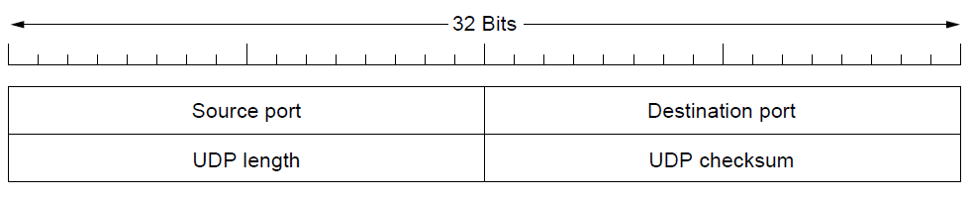
User Datagram Protocol (UDP)
“Best Effort”, connectionless service, without acknowledgements
Reliability can be built at the application layer if required
Error Detection (UDP checksum) but no correction
Ports: TSAPs

Slide 3
Transmission Control Protocol (TCP)
Reliable byte stream between exactly two processes
If the network actually works, TCP guarantees:
Delivery of all data (without any losses), without errors and in the correct order.

Slide 4
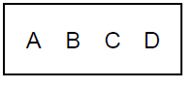
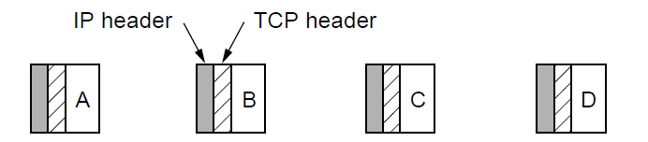
The TCP Service Model
The sending application transmits 2048 bytes of data as a single chunk
TCP splits this to four 512-byte segments sent as separate IP diagrams
The receiving application sees 2048 bytes of data delivered to it

Slide 5
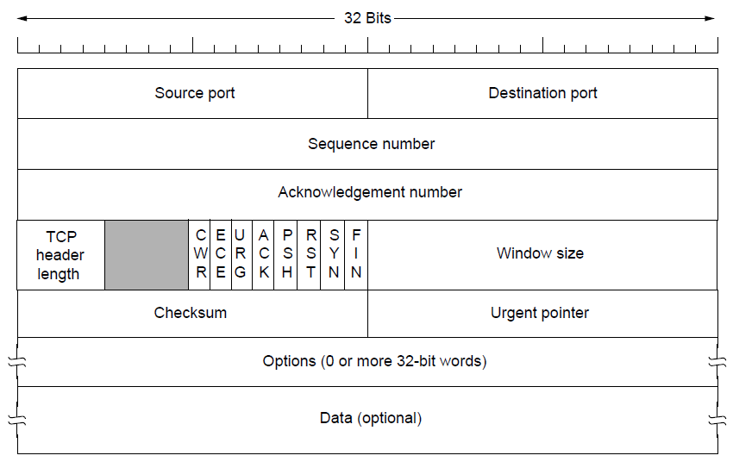
The TCP Segment Header

